Slide 1
Chapter 5: Regression
Part 1

Slide 2
What is regression? Why do we use it?
Regression analysis is a statistical technique used to describe relationships among variables
Generally, in regression analysis, you usually consider some phenomenon of interest and have a number of observations. Each observation has two or more features. Following the assumption that (at least) one of the features depends on the others, you try to establish a relation among them.
In other words, you need to find a function that maps some features or variables to others sufficiently well.

Slide 3
Baseline for any regression
Survey Respondent | Grades in Class
1 | 70
2 | 95
3 | 80
4 | 86
5 | 78
6 | 90
7 | 93
8 | 87
9 | 75
10 | 98

Slide 4
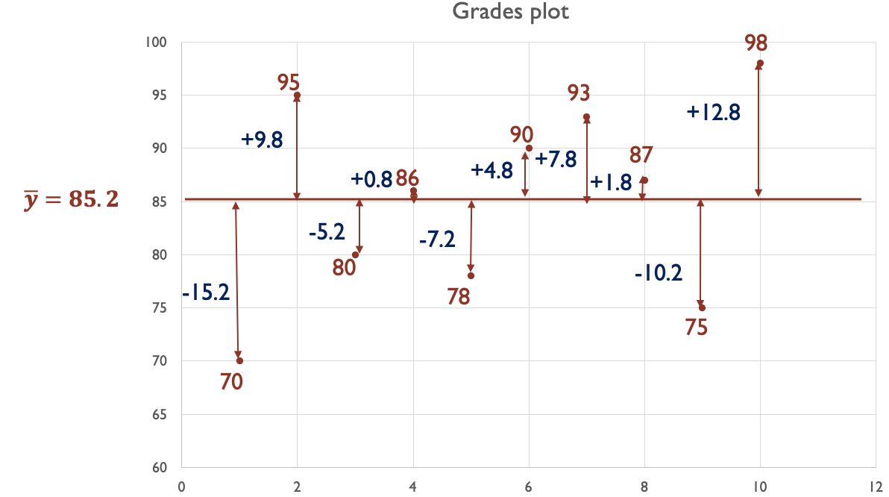
Baseline for any regression

Slide 5
Linear regression
Regression is not necessarily linear (we’ll see both, but not today)
Linear regression
The statistical way
Method: OLS
Ordinary Least Squares
The machine learning way
Method: Gradient Descent

Slide 6
Terminology
Anything with a bar means mean value. Example ȳ
Anything with a hat means predicted value. Example ŷ
Dependent variable: the variable that we want to predict denoted as y
Independent variable(s): the variable(s) that we’ll use to determine the dependent variable denoted as x₁, x₂…etc
Residuals: difference between the observed (real) value and the predicted value

Slide 7
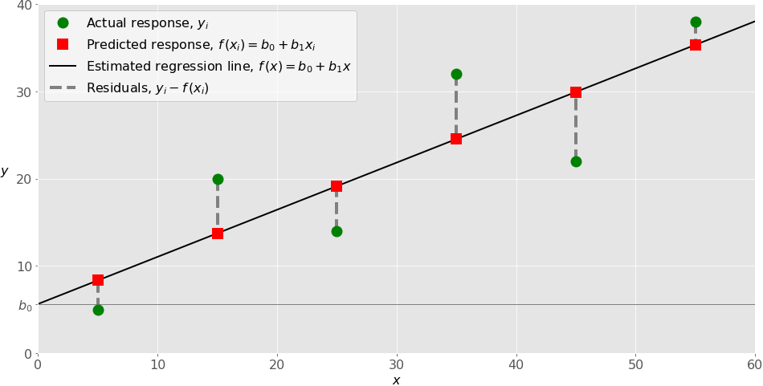
Example
Source: https://realpython.com/linear-regression-in-python/

Slide 8

Simple Linear Regression
1 Dependent variable y
1 Independent variable X₁
The goal is to find a function f(X₁)= $\hat{y}$= β₀ + β₁X₁
Where β₀ is the intercept and β₁ is the slope

Slide 9
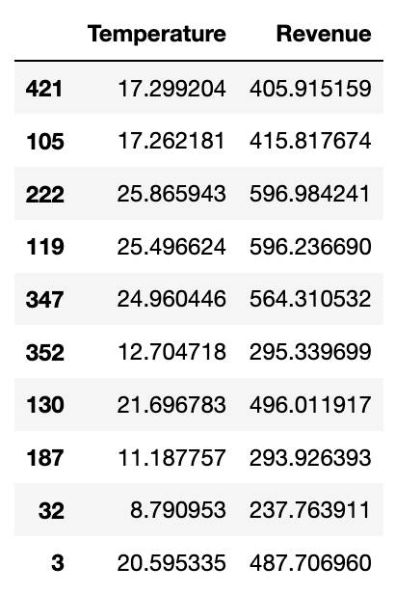
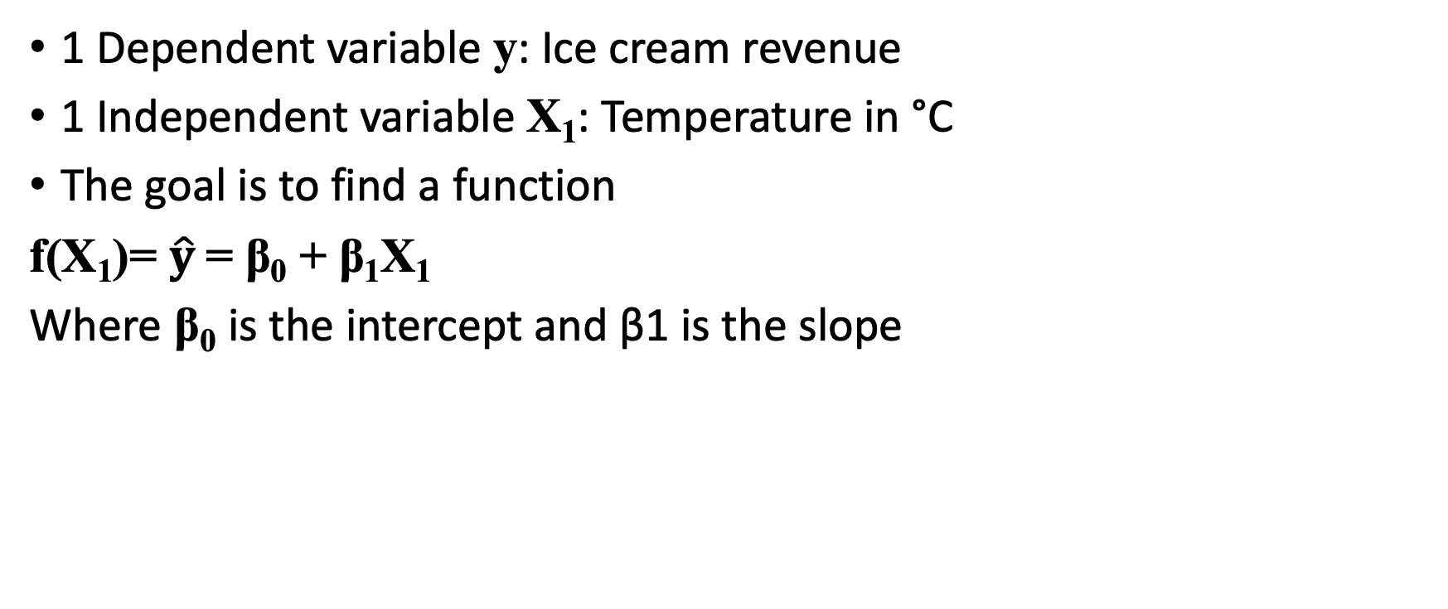
Example: Ice cream sales
1 Dependent variable y: Ice cream revenue
1 Independent variable X₁: Temperature in °C
The goal is to find a function
f(X₁)= $\hat{y}$= β₀ + β₁X₁
Where β₀ is the intercept and β1 is the slope

Slide 10
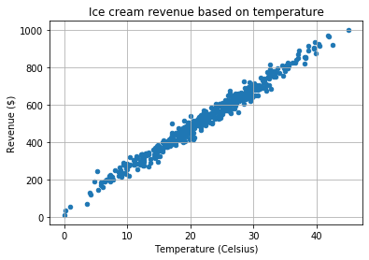
Example: Ice cream sales

Slide 11
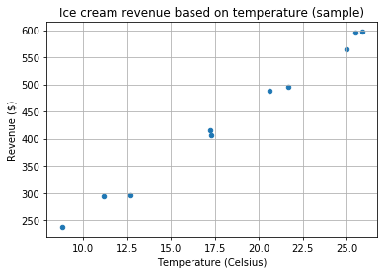
Example: Ice cream sales

Slide 12
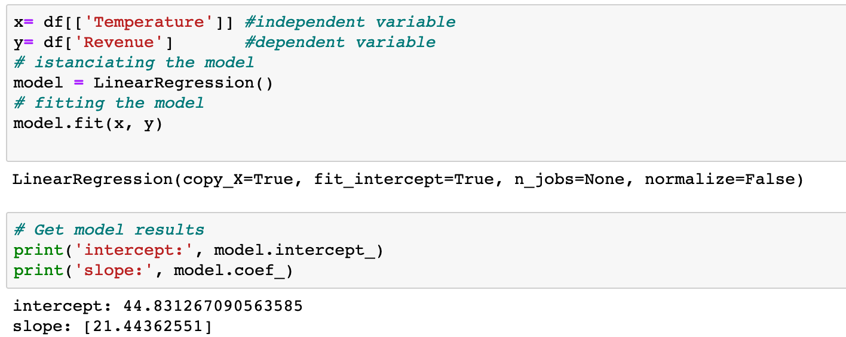
Example: Ice cream sales (creating the model)
Ŷ = 44.831 x + 21.4436
β₀ = 21.4436 and β₁ =44.831

Slide 13
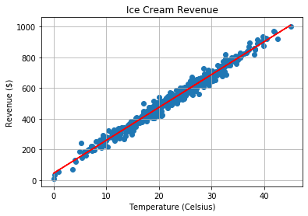
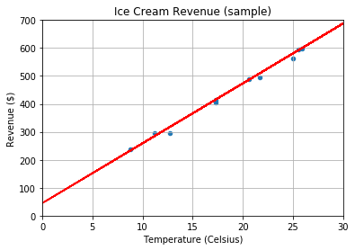
Example: Ice cream sales (plotting results)

Slide 14
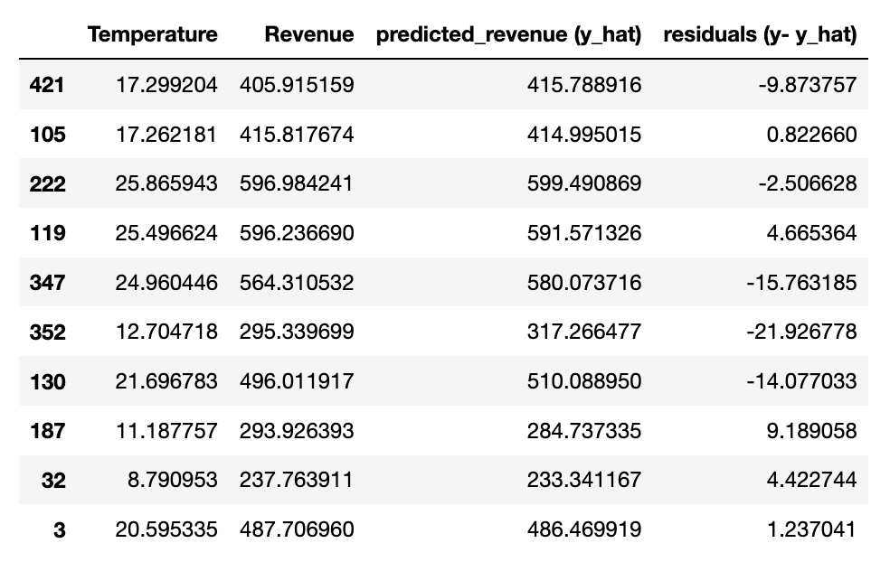
Example: Ice cream sales (Residuals)

Slide 15
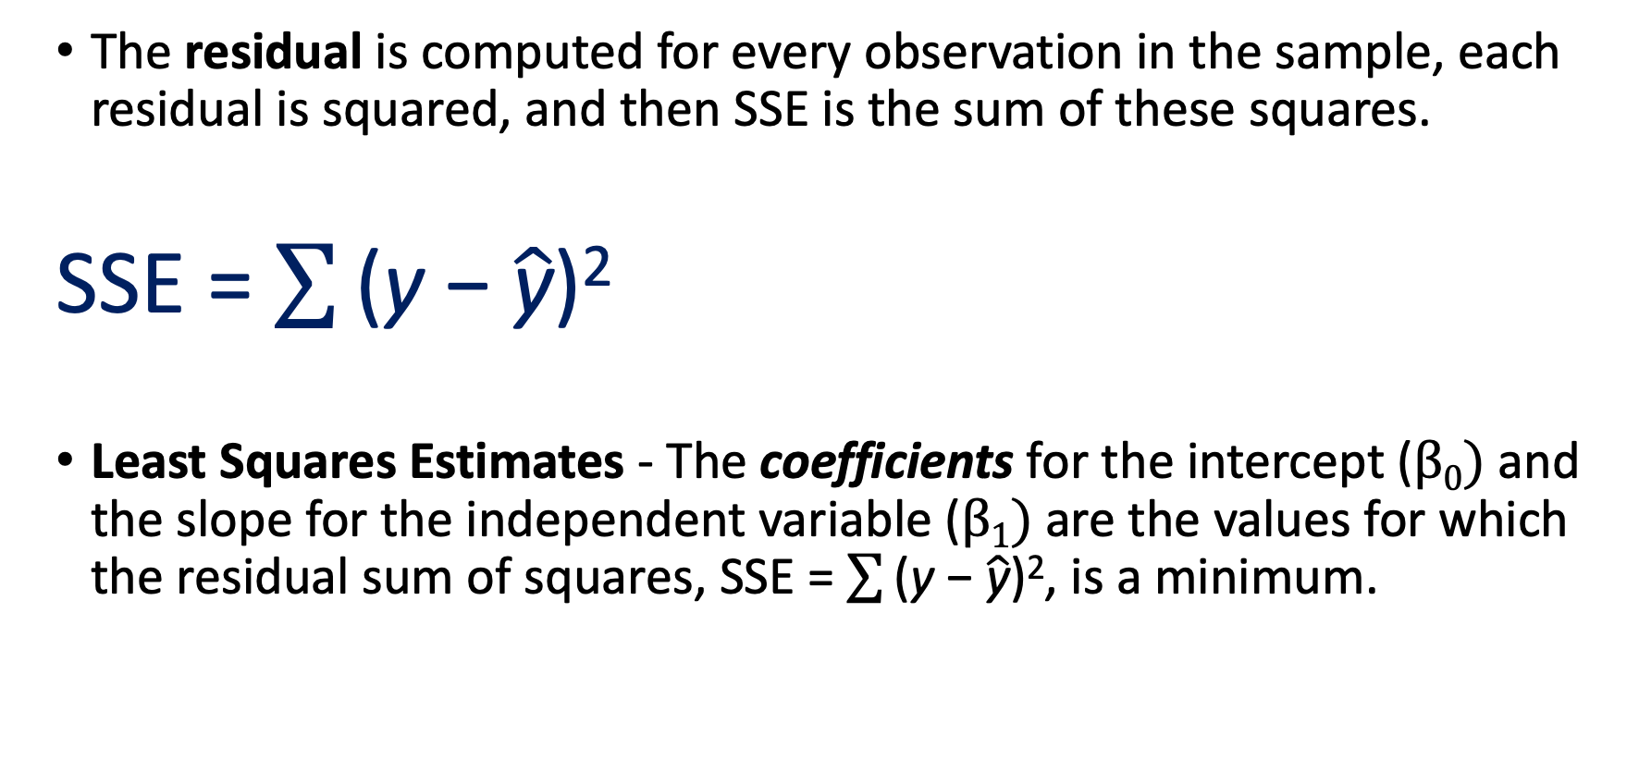
Residuals and least squares
The residual is computed for every observation in the sample, each residual is squared, and then SSE is the sum of these squares.
SSE = $\sum{\text{(}\text{y} \text{− }\hat{\text{y}}\text{)}\text{2}}$
Least Squares Estimates - The coefficients for the intercept (β₀) and the slope for the independent variable (β₁) are the values for which the residual sum of squares, SSE = $\sum{\text{(}\text{y} \text{− }\hat{\text{y}}\text{)}\text{2}}$, is a minimum.

Slide 16
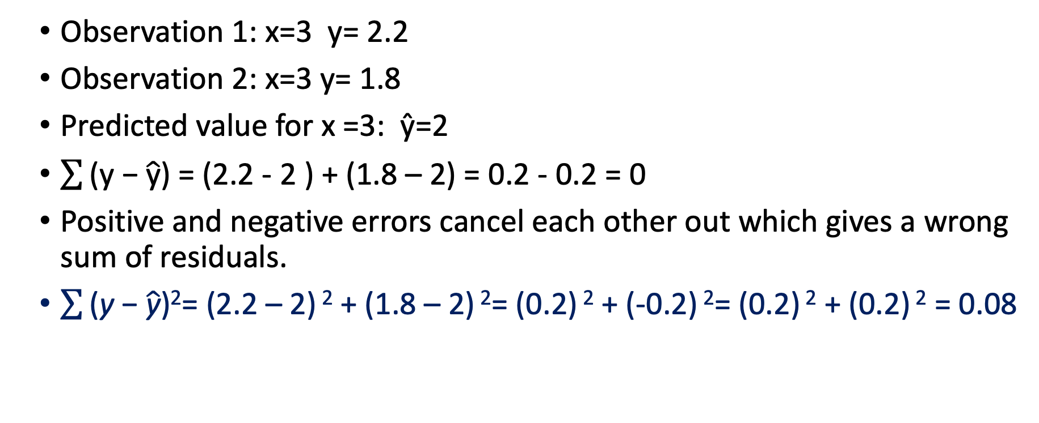
Why do we use square values?
Observation 1: x=3 y= 2.2
Observation 2: x=3 y= 1.8
Predicted value for x =3: ŷ=2
$\sum{\text{(}\text{y}\text{ − }\hat{\text{y}}\text{)} }$= (2.2 - 2 ) + (1.8 – 2) = 0.2 - 0.2 = 0
Positive and negative errors cancel each other out which gives a wrong sum of residuals.
$\sum{\text{(}\text{y} \text{− }\hat{\text{y}}\text{)}\text{2}}$= (2.2 – 2) $\text{2}$ + (1.8 – 2) $\text{2}$= (0.2) $\text{2}$ + (-0.2) $\text{2}$= (0.2) $\text{2}$ + (0.2) $\text{2}$ = 0.08

Slide 17
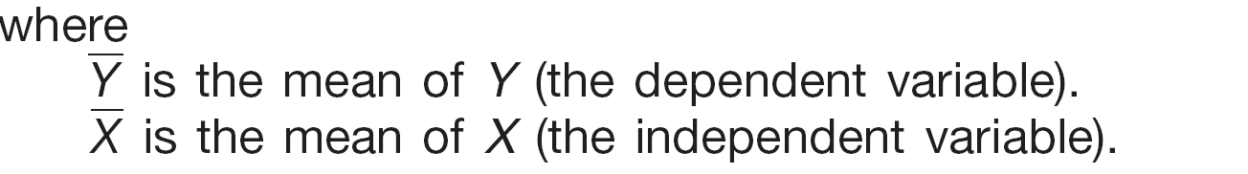
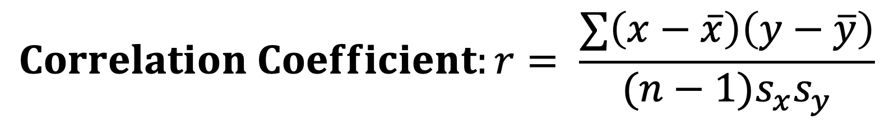
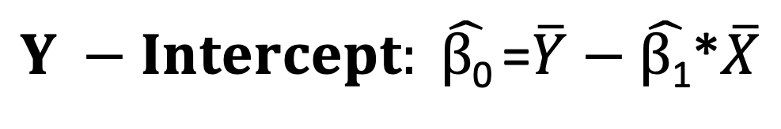
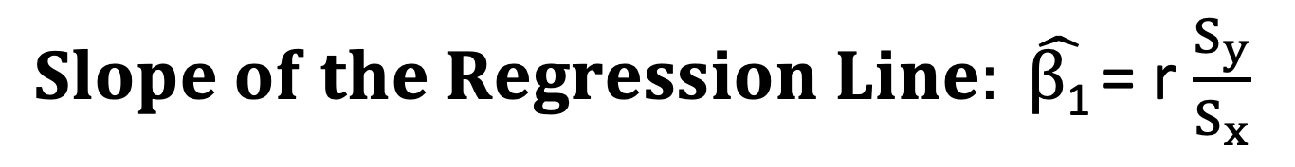
Calculating coefficients:
$Slope of the Regression Line: \hat{β\text{1}}$= r $\frac{S_{y}}{S_{x}}$
$$Correlation Coefficient:r= \frac{∑\left(x−\overline{x}\right)\left(y−\overline{y}\right)}{(n−1)s_{x}s_{y}}$$
$Y −Intercept: \hat{β\text{0}}$=$\overline{Y}−\hat{β\text{1}}$*$\overline{X}$

Slide 18
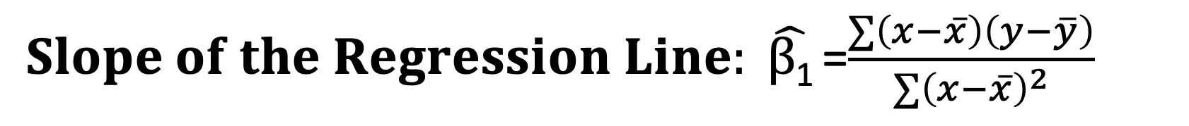
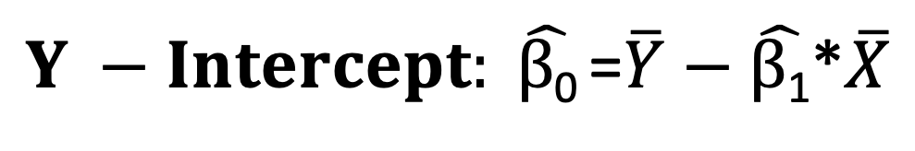
Calculating coefficients (after simplification)
$Slope of the Regression Line: \hat{β\text{1}}$=$\frac{∑\left(x−\overline{x}\right)\left(y−\overline{y}\right)}{{∑\left(x−\overline{x}\right)}^{2}}$
$Y −Intercept: \hat{β\text{0}}$=$\overline{Y}−\hat{β\text{1}}$*$\overline{X}$

Slide 19
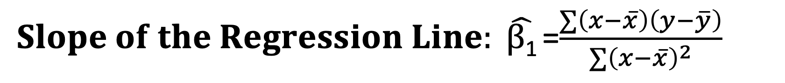
Calculating coefficients (after simplification)
$Slope of the Regression Line: \hat{β\text{1}}$=$\frac{∑\left(x−\overline{x}\right)\left(y−\overline{y}\right)}{{∑\left(x−\overline{x}\right)}^{2}}$
$Y −Intercept: \hat{β\text{0}}$=$\overline{Y}−\hat{β\text{1}}$*$\overline{X}$

Slide 20
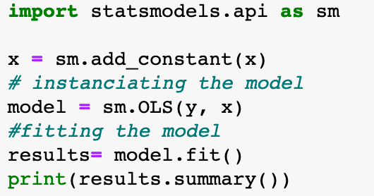
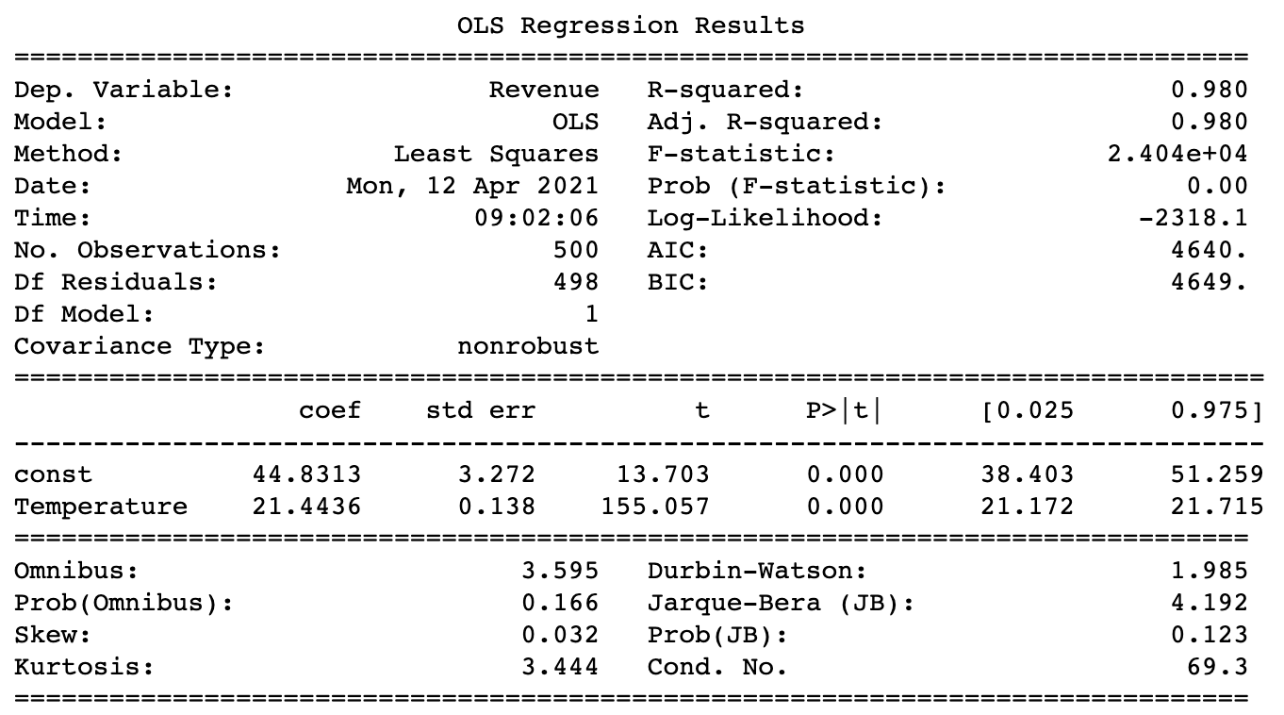
Statistical model

Slide 21
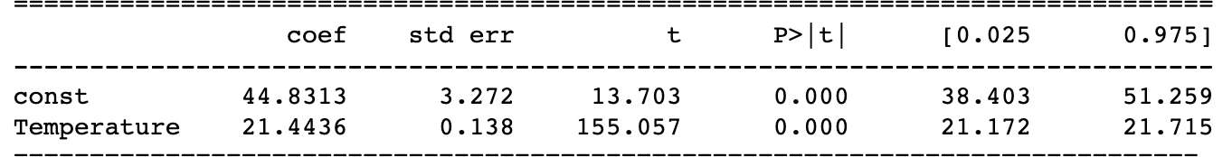
Statistical model: interpreting coefficients
Intercept interpretation:
The Ice cream revenue is 44.8313 when all the other variables are equal to zero
Temperature variable interpretation:
For each unit increase of the variable Temperature, the revenue increases with 21.4436 dollars

Slide 22
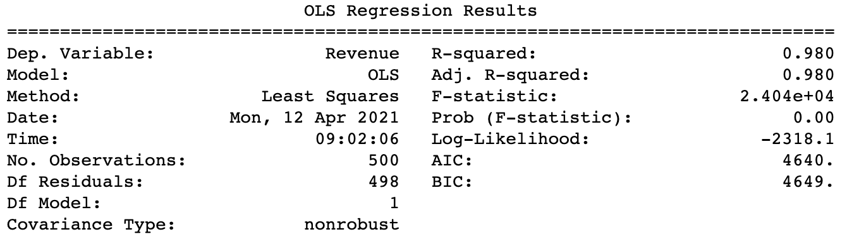
Statistical model: Assessing Model Fit
The coefficient of determination (r²) is the proportion of the total variation in the dependent variable (Y) that is explained or accounted for by the variation in the independent variable (X). It is the square of the coefficient of correlation.
Ranges from 0 to 1
Does not give any information on direction of relationship between the variables.
R-square is the proportion of total variation in the dependent variable y that is explained or accounted for by the variation in the independent variable x.
The coefficient of determination is simply the correlation coefficient squared
r-square is equal to 0.98. In other words, 98% of the variation in ice cream revenue can be explained by the variation of temperature

Slide 23
Statistical model: Assessing Model Fit
The F-Test is what we use when we want to assess whether the linear regression as a whole is statistically significant.
Note that this is slightly different than our test of whether the slope is significant, though the two are obviously related. Main difference is that an F-test can be used when we have multiple IVs and want to test significance of model as a whole.
The F test tests the probability that ALL of the beta’s equal zero (none of the variables have any effect).
In OLS regression, we often refer to the F-Test as the global test, which is because it is the test that is used to evaluate the regression equation as a whole. Later you will learn about a related procedure, called a “nested” F-Test.

Slide 24
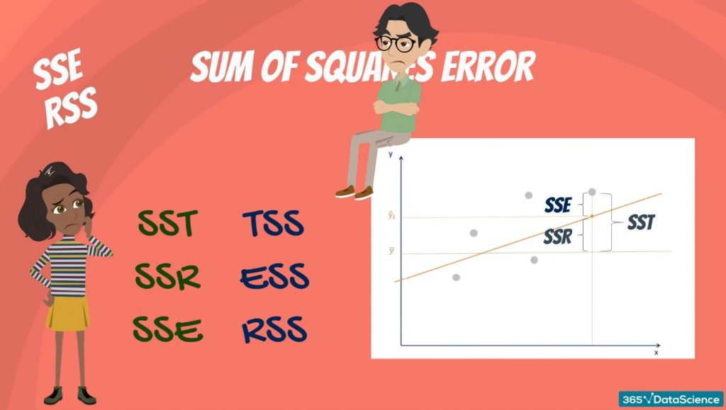
Good to remember
Source:https://365datascience.com/tutorials/statistics-tutorials/sum-squares/

Slide 25
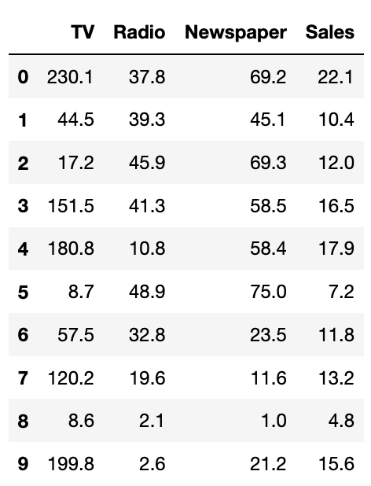
Which variable to choose?
Advertizing / sales data
The sales are in thousands of units and the budget is in thousands of dollars.

Slide 26
Which variable to choose?
Advertizing / sales data
The sales are in thousands of units and the budget is in thousands of dollars.

Slide 27
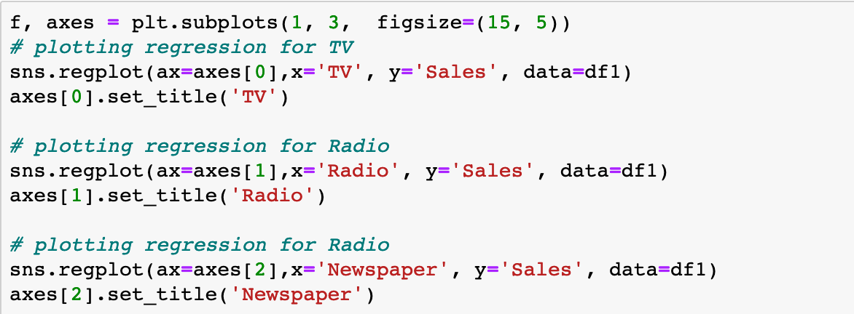
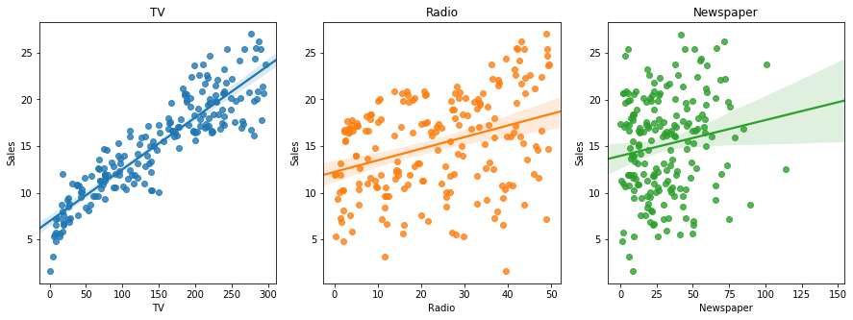
Which variable to choose?

Slide 28
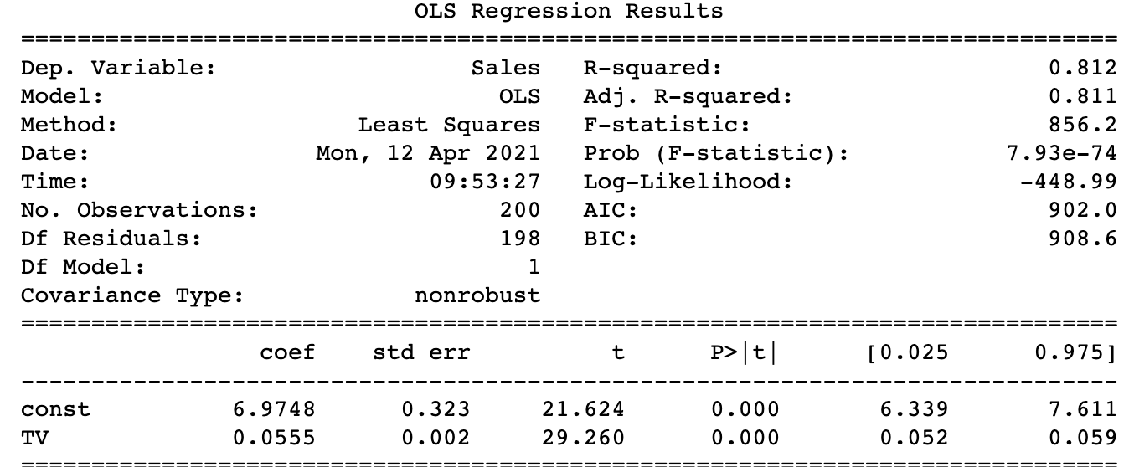
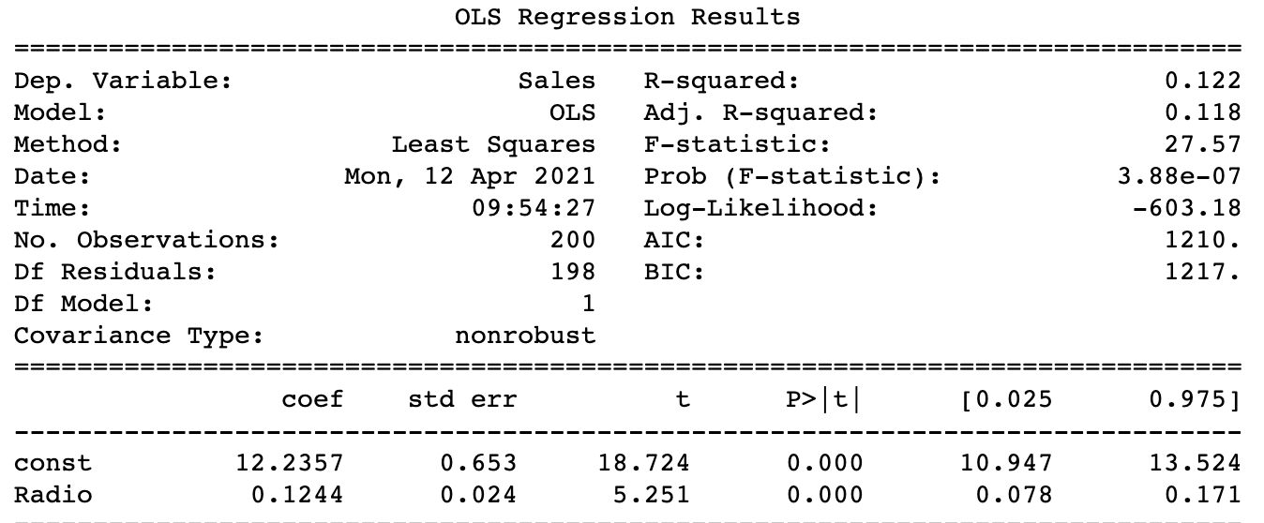
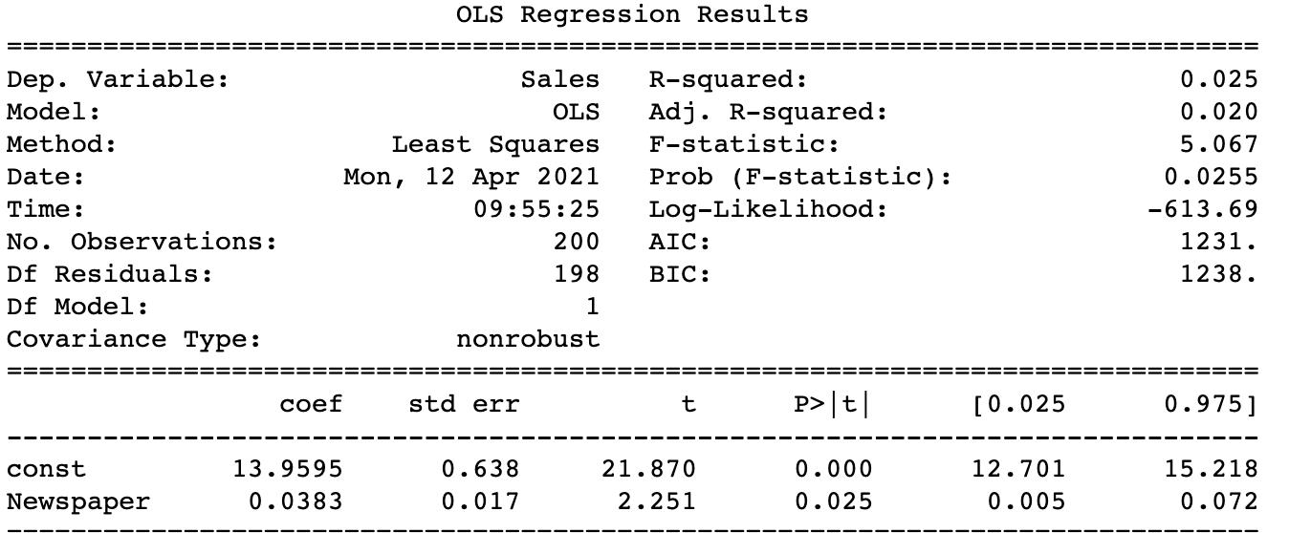
Which variable to choose?

Slide 29
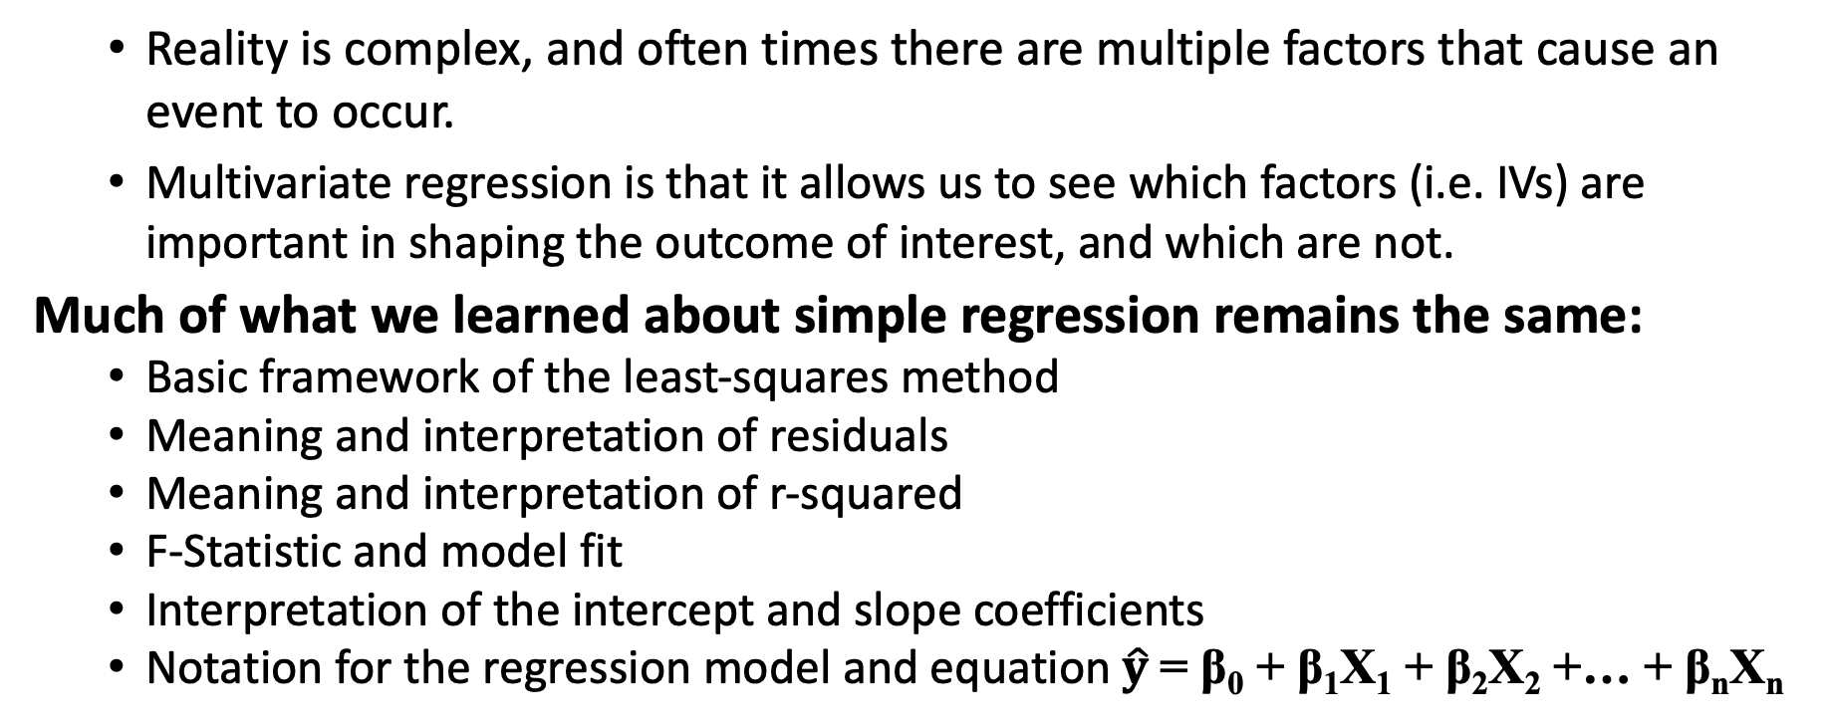
Multivariate Linear regression
Reality is complex, and often times there are multiple factors that cause an event to occur.
Multivariate regression is that it allows us to see which factors (i.e. IVs) are important in shaping the outcome of interest, and which are not.
Much of what we learned about simple regression remains the same:
Basic framework of the least-squares method
Meaning and interpretation of residuals
Meaning and interpretation of r-squared
F-Statistic and model fit
Interpretation of the intercept and slope coefficients
Notation for the regression model and equation $\hat{y}$= β₀ + β₁X₁ + β₂X₂ +… + β_{n}X_{n}

Slide 30
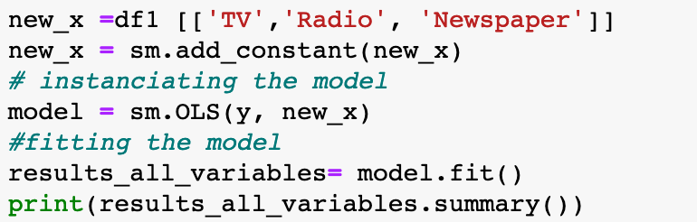
Let’s go back to our previous example

Slide 31
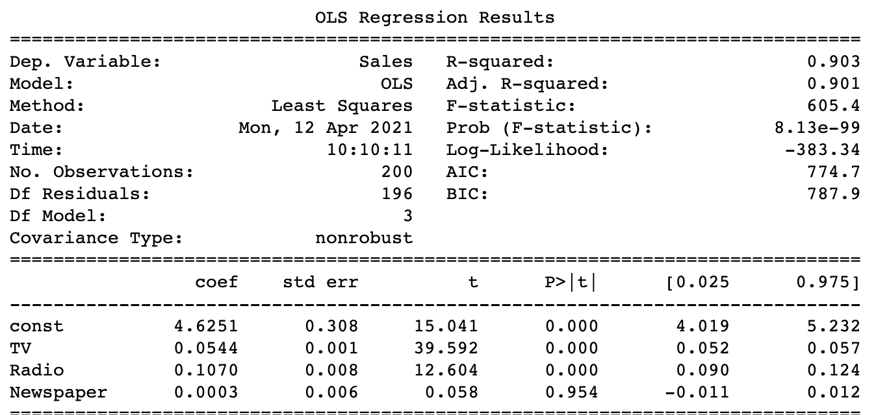
Let’s go back to our previous example

Slide 32
Let’s go back to our previous example

Slide 33
Adjusted R²
Recall that r² represents the
portion of the variation in the
dependent variable that is explained
by the regression model (i.e. all of the independent variables).
One problem with this multiple regression is that the r² will tend to automatically increase when we add extra variables, simply because we lose degrees of freedom.
If the # of IVs is equal to the # of observations (n), r² will equal 1.00.
Higher r² is generally good, but an r² of 1.00 exactly is very bad and generally indicates a serious problems.

Slide 34
Do we drop insignificant variables
While it might be tempting to simply drop all of the statistically insignificant independent variables from the model, there are some good reasons that we shouldn’t always do that.
Often times the failure to reject the null is theoretically and substantively important.
If we always drop insignificant variables, we may miss an important part of the story.

Slide 35
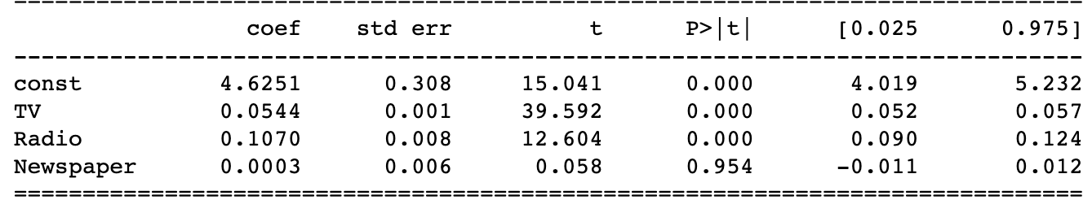
How do we interpret the coefficients?
Ŷ= 4.6251 + 0.0544*(tv ads)+ 0.1070*(Radio ads)+ 0.0003*(newspaper ads)
Intercept: the sales is equal to 4.6251 thousand units when all the other variables are equal to zero. In other words, the sales would be 4.6251 thousand units if no advertising was made.
TV coefficient: for each unit increase in TV advertising, the number of sales units would increase by 0.0544. In other words, for each 1000 dollars invested in TV ads there would be a sale increase of 54 units when all other variables are held constant
Radio coefficient: for each unit increase in Radio advertising, the number of sales units would increase by 0.1070. In other words, for each 1000 dollars invested in Radio ads there would be a sale increase of 107 units when all other variables are held constant
Newspaper coefficient: for each unit increase in newspaper advertising, the number of sales units would increase by 0.0003. In other words, for each 1000 dollars invested in newspaper ads there would be a sale increase of 0.3 units when all other variables are held constant

Slide 36
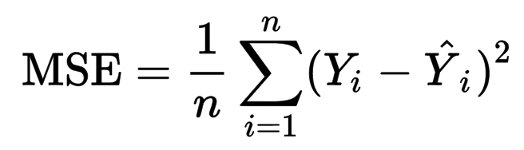
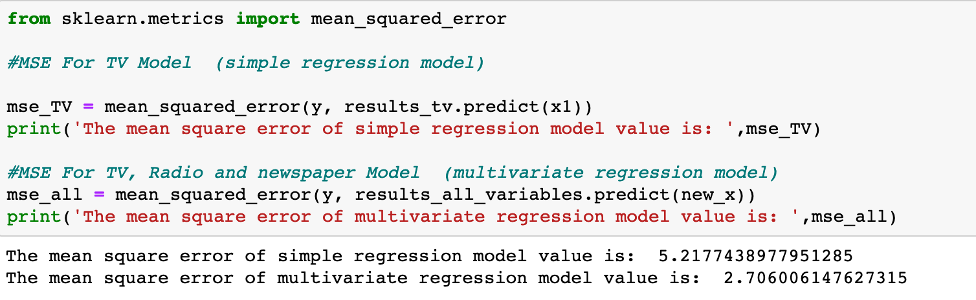
How to evaluate models?
Visually yes but no very efficient
P-values, and significance tests
R squared
MSE ( Mean Square Errors) :

Slide 37
How to evaluate models?
Visually yes but no very efficient
P-values, and significance tests
R squared
MSE ( Mean Square Errors) :
Ultimately, decisions about including/dropping IVs should primarily be driven by the theory you are testing, not by mindlessly looking at regression outputs.

Slide 38
Near Multicollinearity
Imperfect (near) multicollinearity occurs when two or more regressors are very highly correlated.
Results in loss of statistical resolution:
Large standard errors
Low t-stats, high p-values
Enormous sensitivity to small changes in data or model specification
Solutions
Drop one or other of co-linear variables
Caution: May result in model misspecification
Use theory as a guide
Add new data
Special samples may maximize independent variation
Data Scaling

Slide 39
Prefect Multicollinearity
A set of variables are perfectly multicollinear if a variable is a constant, or if there is an exact linear relationship between a set of variables.
lf X₁=X₂, then X₁ and X₂ are perfectly collinear.
If X₂ is a linear function of X₁(i.e. if X₂ = X₁ plus, minus, multiplied or divided by some constant number) then X₁ and X₂ are perfectly collinear.
dummy variables have perfect multicollinearity( example male female)
lf there is perfect multicollinearity, one of the β parameters cannot be estimated.
Intuitively, if an additional X variable adds no new information, we cannot estimate its effect on Y.

Slide 40
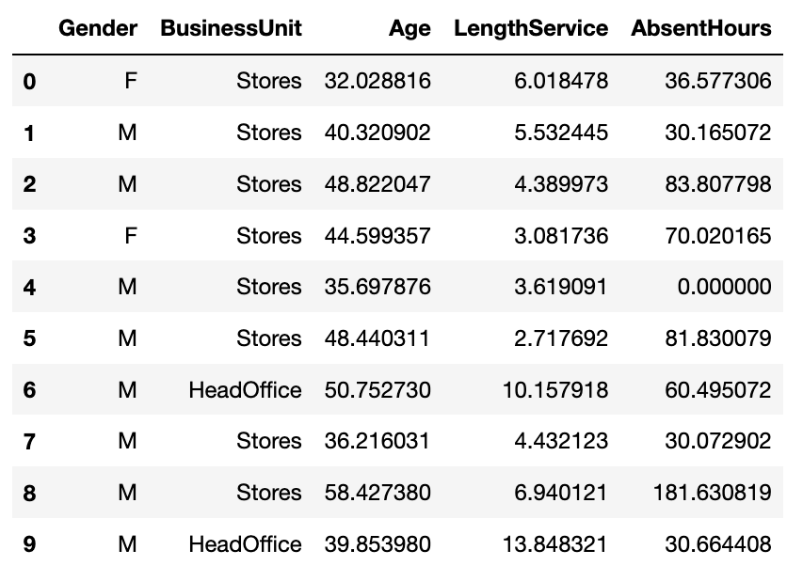
How do we deal with categorical variables in regression?

Slide 41
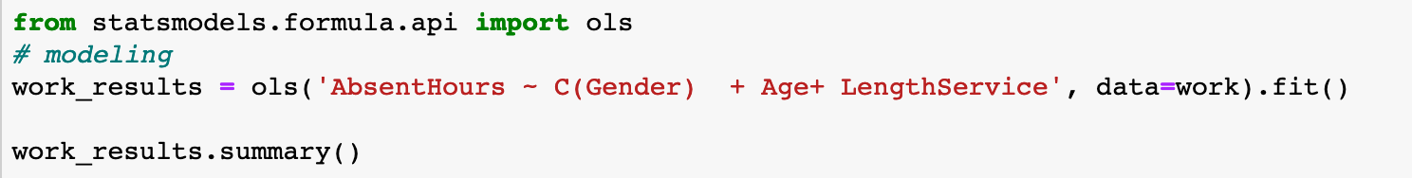
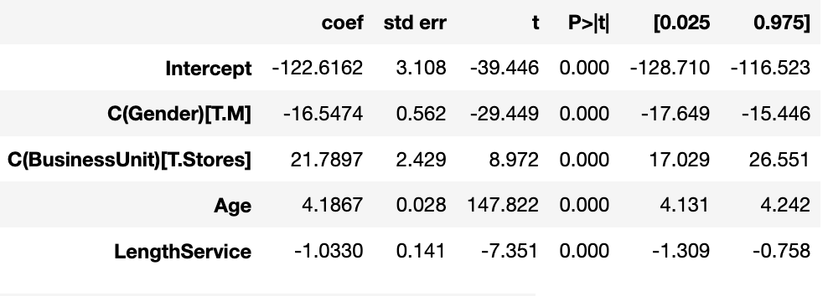
How do we deal with categorical variables in regression?
Intercept interpretation:
The number of absence hours for a female working in Head office is equal to -122.6161 when all other variables are equal to zero
(weird value because technically age can’t be equal to zero)

Slide 42
How do we deal with categorical variables in regression?
Gender (male): 1 unit shift (from female to male) in the variable gender results in a decrease of Absence hours by 16.54 hours when all the other variables are held constant. In other words, a male and a female with the same age, working in the same business unit (either store or head office) and the same length of service, the male would be have 16.54 absent hours than the female.
Business unit (Store): 1 unit shift (from Head office to store) in the variable business unit results in an increase of Absence hours by 21.78 hours when all the other variables are held constant. In other words, two people from the same gender, with the same age and length of service, the one working in the store is absent 21.78 hours more than the person working in the Head office

Slide 43
How do we deal with categorical variables in regression?
Age: 1 unit increase in the variable age results in an increase of of Absence hours by 4.18 hours when all the other variables are held constant.
Length service : 1 unit increase in the variable length of service results in decrease of of Absence hours by 1.033 hours when all the other variables are held constant.

